Slide 1


Human Computer Interaction
Computer Science Department
BSIT Fall 2019

Slide 2
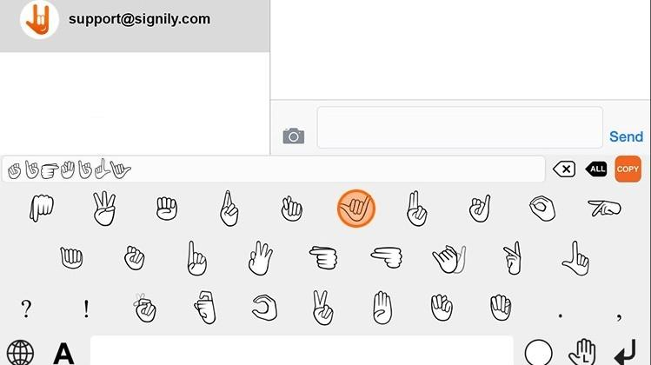

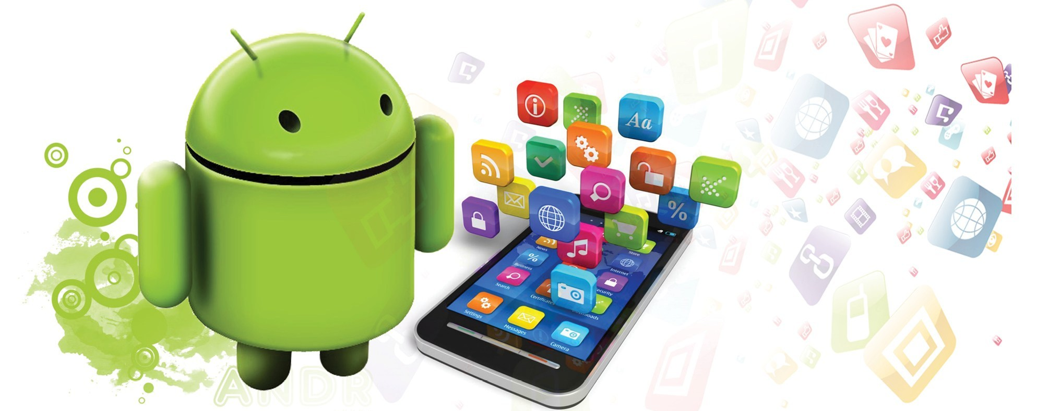
Human Computer Interaction
Chat with Deaf
(Chatting Application)
Group Members
Hifsa Basharat (45903)
Haris Anwer (45902)
Muhammad Laraib Kiyani (45916)
Submitted to
(Ms. Aniqa Naeem)
Computer Science Department
BSIT Fall 2019

Slide 3
Overview
Human Computer Interaction
Introduction to Project
Problem Statement
Objectives
Interaction & Interface Style
Rules for interface design
Universal Design Principle
Ergonomics
Use Case Diagram
Screenshots
References
Computer Science Department
BSIT Fall 2019

Slide 4
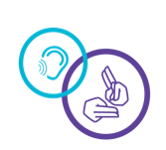
Introduction
FYP Project: Chat With Deaf
Studies have found that deaf people are around twice as likely to suffer from depression and anxiety. The suggestion from most researchers is that these issues are a result of the isolation associated with deafness.
Differences among deaf people are okay, but we need to recognize those
differences and work together
Infections are also a Common Cause, as are birth defects, genetics, reaction to drugs, especially chemotherapy or drugs used for cancer treatment & Exposure to loud noise.
Our Project Is!
Developing full fledged android app which to fill the gap between normal & Deaf people using Algorithms & Different Techniques.

Slide 5

Problem Statement
The problem with existing application is that some are static, some have only text sending option, some have only voice sending option. No standard App is completely providing all options which are necessary for a deaf to communicate with other deaf or a normal human.
No one has worked for generating predictions about the next action or sign of deaf person.
In educational institution it is very difficult to teach students the interrelation between sign and English language alphabets, & for those who have not even attended their schools is impossible to learn & deliver accurate signs
So According to us the solution is to combine all the possible chatting options?? Why Not!!
To solve the above challenges, there is a need to introduce an android app which will help the deaf in every aspect

Slide 6
Project Scope/Modules
FYP Project: Chat With Deaf
As mentioned in proposal the requirements is to build Interactive chatting software that can be used to chat with deaf as it will be a translator also which will translate signs to normal wordings and vice versa.
Facility of communication via messaging between
Normal person with normal person
Deaf with Deaf
Normal person with Deaf
To fulfill these requirements beside other standard app’s options, We will work on 6 modules
Sign to Text
Text to Sign
Sign to Sign
Text to Text
Voice to Text
MODULES

Slide 7
Interaction & Interface Styles
Conversing Type
Interacting by as if having a conversation, Conversing is a way of interaction where the system behaves like a human partner rather than a machine that simply obeys user’s orders.
Menus
It has used menus throughout the application.
Menus increases use of recognition than recall, menu item names are meaningful.
Point and Click Interface
Messenger has used point and click interfaces as the main interaction style.
Clickable items ○ Icons ○ Buttons ○ List items ○ Menu items
A mobile user interface (mobile UI) is the graphical and usually touch-sensitive display on a mobile device, such as a smartphone or tablet, that allows the user to interact with the device's apps, features, content and functions.
Mobile Interface

Slide 8

Rules & Principles of Design
Universal Principles
Equitable Use, available on most of the common platform except Linux based operating systems
Flexibility in use available numerous settings which can be adjustable according user’s preferences
Simple & intuitive to use minimize the language barrier by prioritizing iconic representations
Rules Of User Interface Design
Strive for Consistency between application and cross domain
Cater to universal usability Multi Sensory - Eye, Touch, Ear
Offer Informative Feedback Sounds when sending messages, stickers, emojis
Design Dialogues to yield closure
Prevent Errors

Slide 9
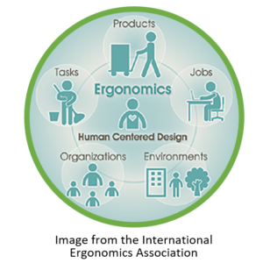
Ergonomics
Arrangement of Controls and Displays
Pop up chat head is the size of a general finger touch, each message in a chat is of perceivable size, each conversation in the list is of perceivable size
No theme changing capability when using device in the day and night (high contrast for eyes), the application cogs up a lot of processing power and battery, which causes the device to heat significantly
We have used orange, white & pale orange color contrast as the main theme colour, to show online users - Consistent and attractive, Use of red for warnings are also present.
Health Issues
Use of Colour

Slide 10
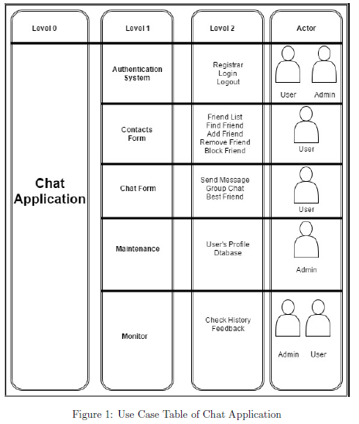
Use Case Diagram

Slide 11
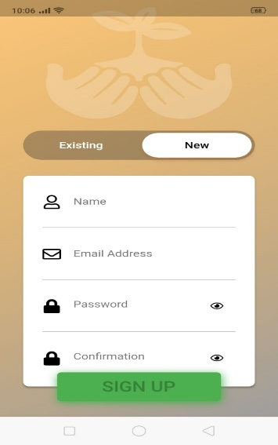
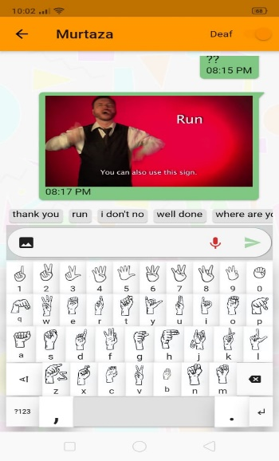
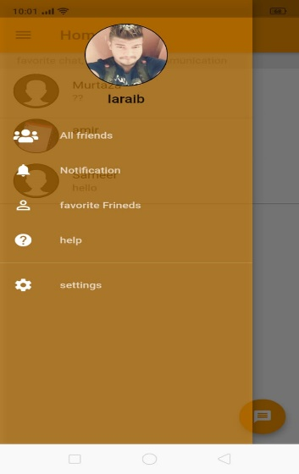
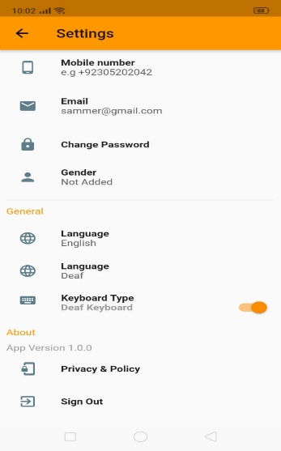
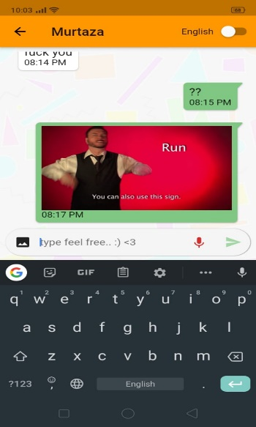
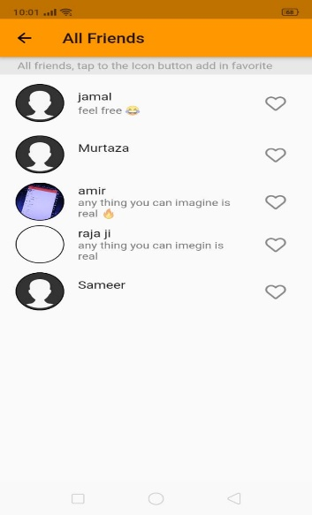
Screenshots of Project

Slide 12

Human Computer Interaction
Any Question??
Computer Science Department
BSIT Fall 2019

